Slide 1

mooDSpHERE
An Emotion Based Music Recommender

Slide 2
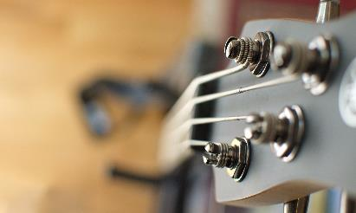

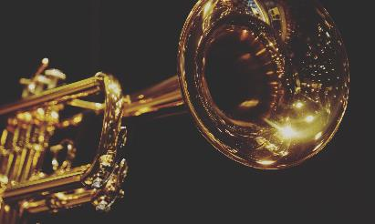
Agenda
Team Member Roles and Responsibilities
Improvements made from Professor Feedback
Project Description
Team-Work Agreement
Personas
MVP
Technologies
Algorithms
Diagrams
Sprint 2 Recap
Product Backlog
Sprint 3 Backlog
Metrics
Retrospective
Sprint 4
Project Demo - Sprint 3 (current sprint)
GitHub link
Live Application Demo
MoodSphere

Slide 3


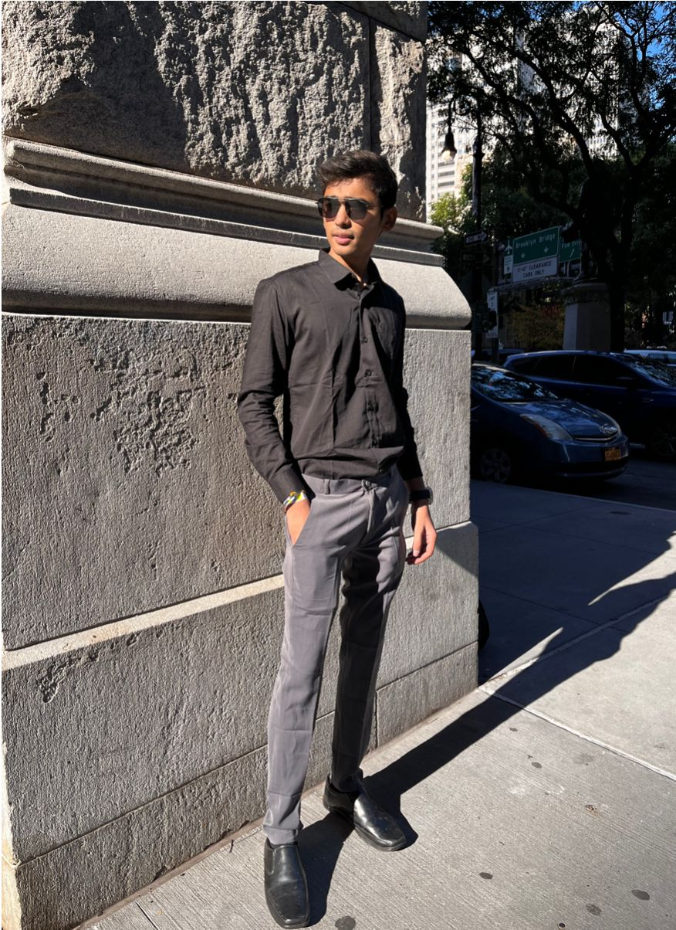

team
Bhavik Chopra
Dhyey Dave
Krushil Sheladiya
Mahesh Nakka
Data Scientist
Lead Developer
UI/UX Developer
Backend developer/QA

Slide 4



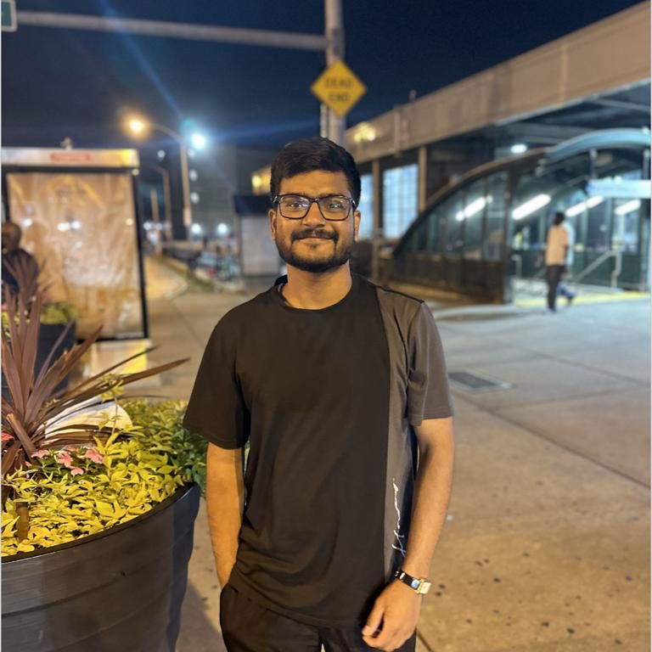
team
Nisarg Bhuva
Shane Parmar
Urmil Trivedi
Vijay Devkate
Scrum Master/QA
Backend Developer/Product Owner
Architect/Developer
ML Engineer/ UI Designer

Slide 5



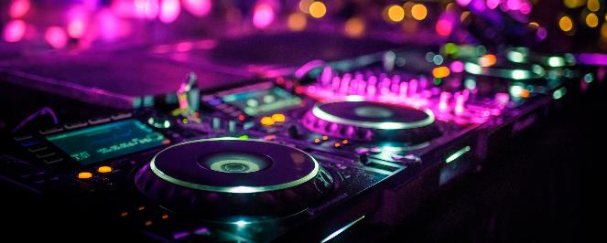

IMPROVEMENTS FROM FEEDBACK + changes
Project Description Format(Slide 5)
Modified more Personas(Slide 10-15)
Modified MVP Explanation(Slide 16-19)
Changed and Added Diagrams(Slide 25-31)
Added Sprint 2 Recap(Slide 32-34)
Updated Product Backlog(Slide 35-41)
Changed User Stories(Slide 43-48)
Added Stories Completed and Not Completed(Slide 49-53)
Added Metrics(Slide 54-71)
This symbol represents the Improvements made.

Slide 6
Project Description
Project Name: | MoodSphere
Team: | DevDynasty
Project Description: | Using facial expression detection techniques and machine learning algorithms in real time to understand the user's mood. for the music enthusiasts seeking a personalized and emotionally resonant listening experience, who wants to listen to their music based on their current emotional state the MoodSphere is an application that takes out the hassle of going through all the options in traditional music applications to hear the right music for their mood, that employs facial recognition and CNNs to analyze your real-time emotional expressions captured through the camera. unlike traditional music recommendation systems solely relying on user preferences, MoodSphere distinguishes itself by incorporating facial emotion analysis. our application dynamically adjusts music recommendations as your emotional expressions evolve allowing users to experience enhanced recommendations within the application.

Slide 7
Problem statement
Conventional music streaming services frequently rely on general recommendation algorithms that ignore emotional relevance, which leaves users' emotional demands unmet. The Emotion-Based Music Recommender using Facial Recognition and Convolutional Neural Networks (CNN) project aims to combine state-of-the-art computer vision techniques in order to address this. The system uses CNNs and facial recognition technologies to accurately assess users' facial expressions for emotional indicators. The goal of this integration of sophisticated machine learning algorithms with visual data is to provide consumers with individualized music recommendations that are in line with their current emotional states, improving their listening experience as a whole.

Slide 8


tEAM-WORK AGREEMENT
MoodSphere

Slide 9
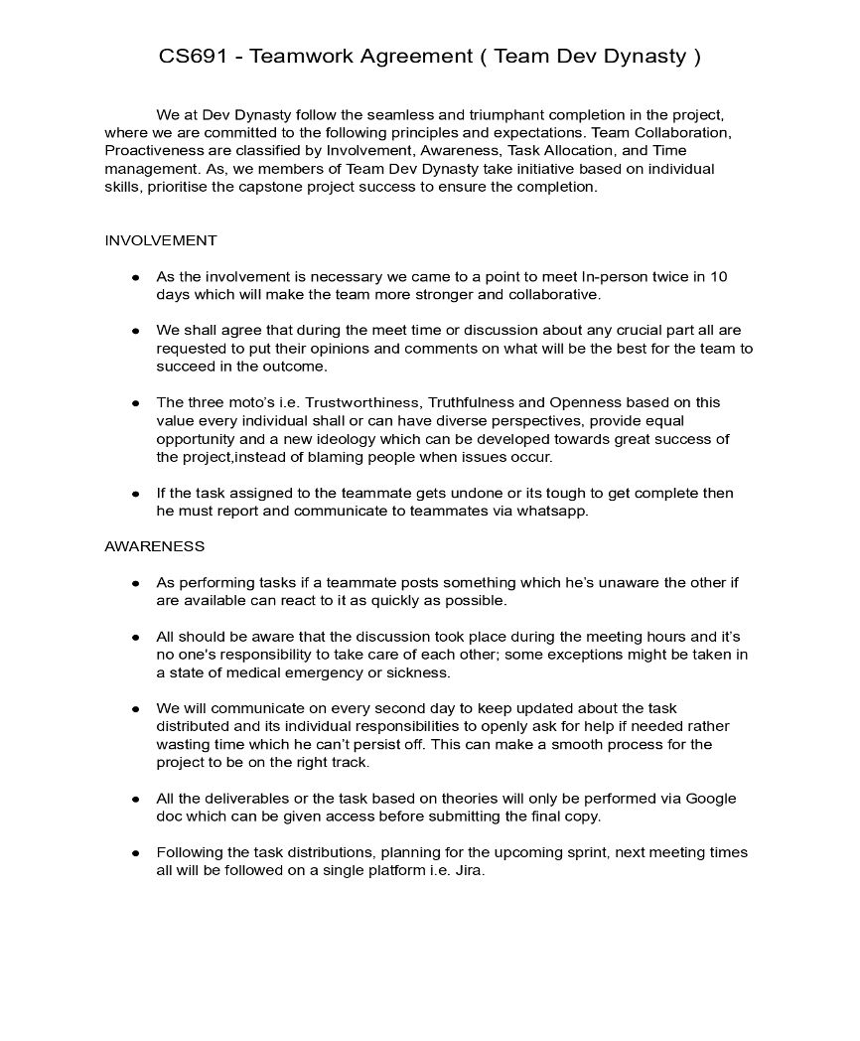
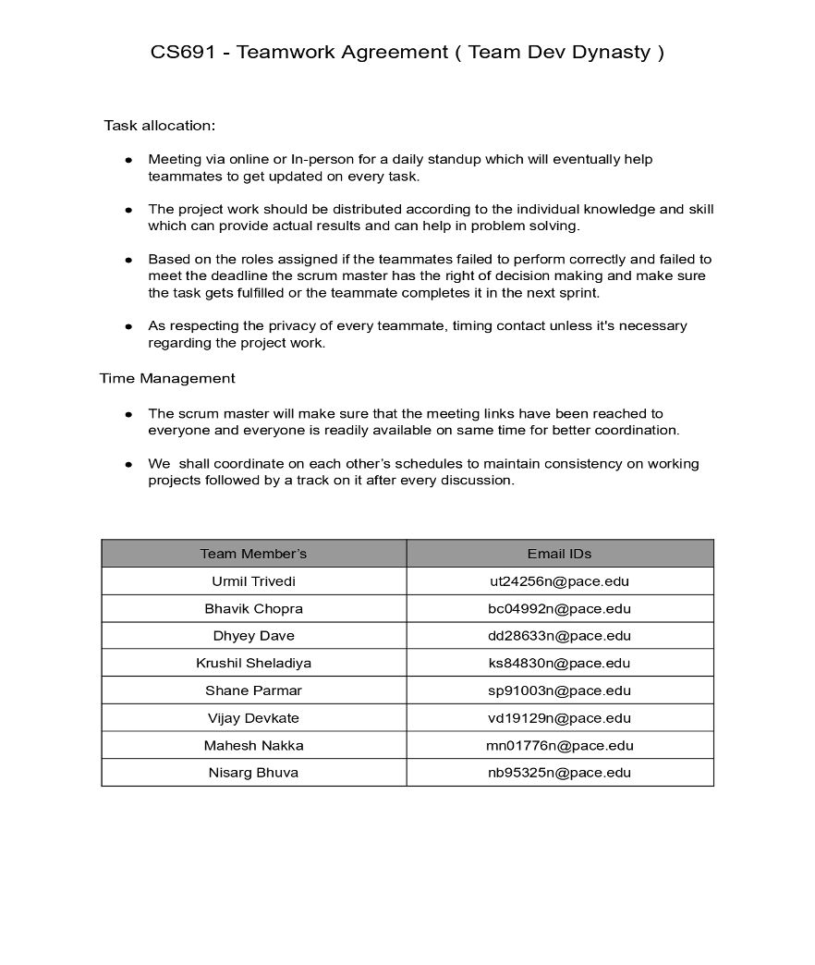

Slide 10
personas

Slide 11

PERSONA 1
Background:
Elena is a 32-year-old project manager in a tech company, often under high stress and pressure of completing project to deliver best outcomes.
Emotional Profile:
Given her high-stress role, Elena values an app that can detect subtle shifts in her mood through her interactions — be it the pace at which she scrolls or the time of day — and adjust the music without her needing to manually search for tracks. This anticipates her needs and saves time, allowing her to remain focused on her work or relaxation.
Elena
Technical Project Manager
Preferred Genres:
Classical for relaxation, soft rock for mood uplift, ambient for focus.
Interests:
Yoga, meditation, and wellness podcasts.
MoodSphere

Slide 12

PERSONA 2
Background:
Max is a 27-year-old fitness trainer reliant on energetic music during workouts to stay energized and motivated.
Emotional Profile:
Seeks dynamic, high-tempo music for workouts and calming tunes for cooldowns. The app would suggest serene and tranquil music, aiding in the transition from high activity to relaxation. The app could potentially measure the duration of the workout to time the cooldown music perfectly.
Max:
The Energetic Fitness Enthusiast
Preferred Genres:
Upbeat EDM for workouts, soft instrumentals for cooldowns.
Interests:
High-intensity interval training, marathons, and sports nutrition.
MoodSphere

Slide 13

PERSONA 3
Background:
Lia is a 20-year-old freelance writer who works from home on content on client’s demand
Emotional Profile:
Her choice of music transcends mere background ambience, acting as a vital catalyst for her focus and creativity. It's this profound relationship with music that not only entertains but also significantly nurtures her artistic expression and emotional health. Each melody plays a specific role in her day, meticulously chosen to align with her feelings, thereby transforming her workspace into a sanctuary for inspiration and emotional balance.
Lia:
Remote Worker
Preferred Genres:
Lo-fi hip hop, smooth jazz, and classical.
Interests:
Creative writing, reading, and interior design.
MoodSphere

Slide 14

PERSONA 4
Background:
Sam is a 35-year-old commuter who has long commutes and uses music to mentally prepare or unwind
Emotional Profile:
Sam needs energizing music in the morning and relaxing music in the evening.
Sam also seeks music that can serve as a personal soundtrack to the rhythm of the city during his commutes, providing a sense of connection and vitality. In moments of stress or fatigue, he looks for tracks that can offer solace and a mental escape, helping to rejuvenate his spirit.
Sam:
The Commuter
Preferred Genres:
Pop and indie for energy, acoustic for relaxation.
Interests:
Travel podcasts, audiobooks, and city walking tours.
MoodSphere

Slide 15

PERSONA 5
Background:
Zara is a 22-year-old culinary student who enjoys cooking with music which makes her mood calm and focused.
Emotional Profile:
Zara seeks music that matches the energy of her cooking sessions
Zara enjoys music that keeps her kitchen lively and her mind sharp while she cooks. She also likes songs that go well with the different kinds of food she makes, making her cooking feel more special.
Zara:
An Aspiring Chef
Preferred Genres:
Upbeat Latin for cooking, classical for baking.
Interests:
World cuisines, food blogging, and cooking shows.
MoodSphere

Slide 16
MINIMAL VIABLE PRODUCT(MVP)
MoodSphere

Slide 17
MINIMUM VIABLE PRODUCT
Web application with user emotion prediction and song recommendation functionality.​
Allowing user to create an account in the application.​
Interactive UI to display user uploaded image.​
CNN model to predict user's emotion on image input.​
API to accept user image in request and send the model's prediction and the list of songs from static database in response.​
Server to handle the above API along with two different endpoints to send songs based on genre and artist. ​
Model and backend connection to predict emotions. ​

Slide 18
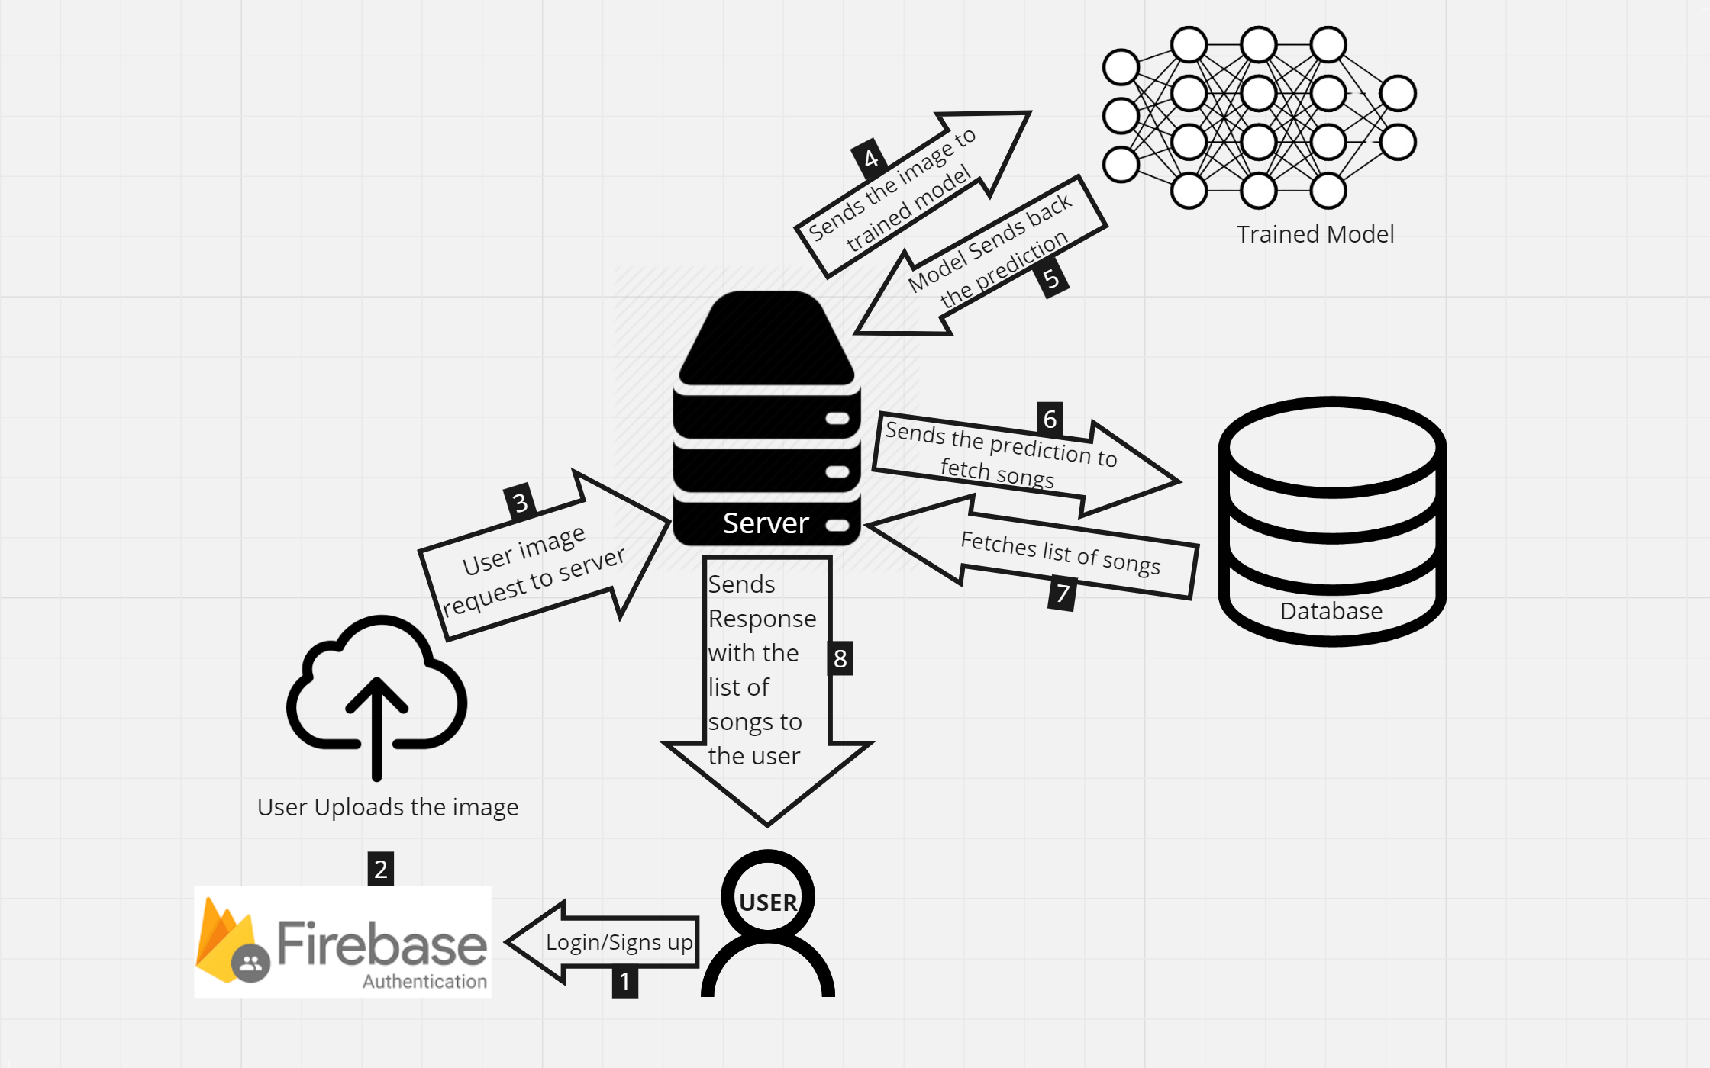
MVP DIAGRAM
MoodSphere

Slide 19
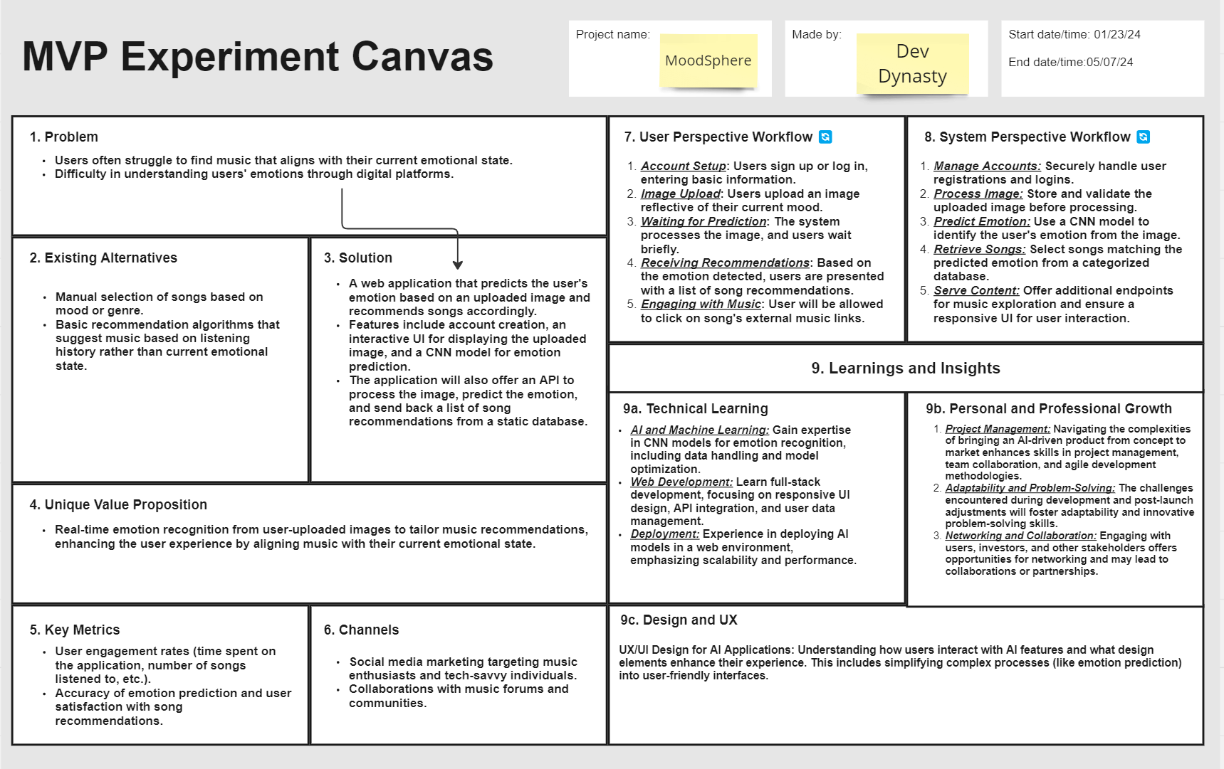

Slide 20
TECHNOLOGIES

Slide 21








Technologies
TensorFlow
React
Firebase
Python
HTML5
CSS3
Flask
Jira

Slide 22
Technologies description
TensorFlow will be the foundation for building the emotion detection engine of our music recommender.
Main applications of using TensorFlow will be Model Development and Real-Time Inference
React serves as the cornerstone for constructing the user interface (UI) of your music recommender app. Main applications of using React will be UI Design and Data Visualization
It is a suite of cloud-based services from Google that simplifies building mobile and web applications by providing features like: Authentication, Database Cloud Functions Hosting Analytics
Python supports OOP principles, allowing you to structure your code using classes and objects. This promotes code reusability, modularity, and maintainability, especially when dealing with complex data structures like user profiles and music recommendations.
MoodSphere

Slide 23
TECHNOLOGIES DESCRIPTION
HTML5 Defines the structure and content of web pages. Creates the basic building blocks of web pages using elements like headings, paragraphs, lists, images, and forms.
CSS3 controls the presentation of web pages, applying visual styles like fonts, colors, layout, and animations.
It defines styles that are applied to HTML elements, controlling their appearance.
High-level web framework built in Python, simplifying the development process for building web applications.
Can be employed to create the backend of your application, handling data processing, routing, and interacting with Jira
Project management software specifically designed for agile teams, facilitating task tracking, issue reporting, and collaboration.
MoodSphere

Slide 24
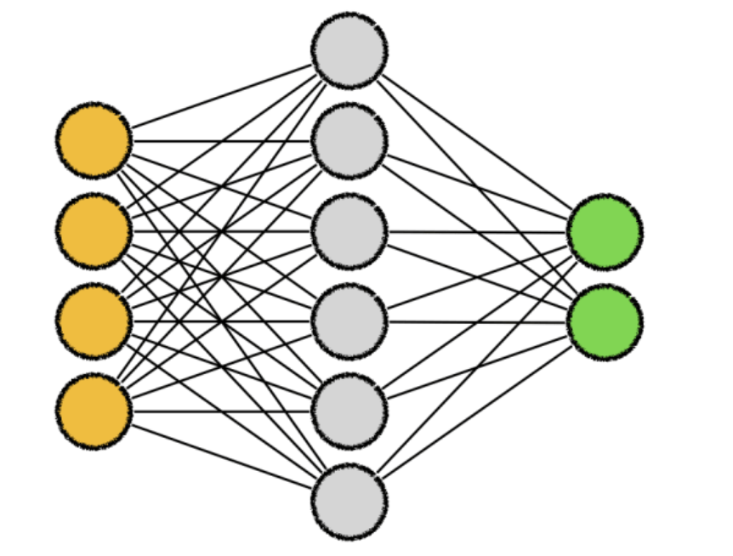


Algorithms AND EXPLANATION
Convolutional neural networks (CNNs) are a form of deep neural network that are frequently used in computer vision tasks like object detection, picture segmentation, and image recognition. When the term "CNN algorithm" is used, it usually refers to CNNs.
ResNet-50 is a deep convolutional neural network with 50 layers, renowned for its use of residual connections that aid in training very deep networks. Because of its outstanding performance in tasks like object identification, picture segmentation, and image classification, it has been frequently used in computer vision applications.
Keras is a popular Python framework that makes neural network construction and training (simple and straightforward). It provides an elevated interface to deep learning frameworks like as TensorFlow and Theano, facilitating swift model deployment and development.​
MoodSphere

Slide 25
Diagrams

Slide 26


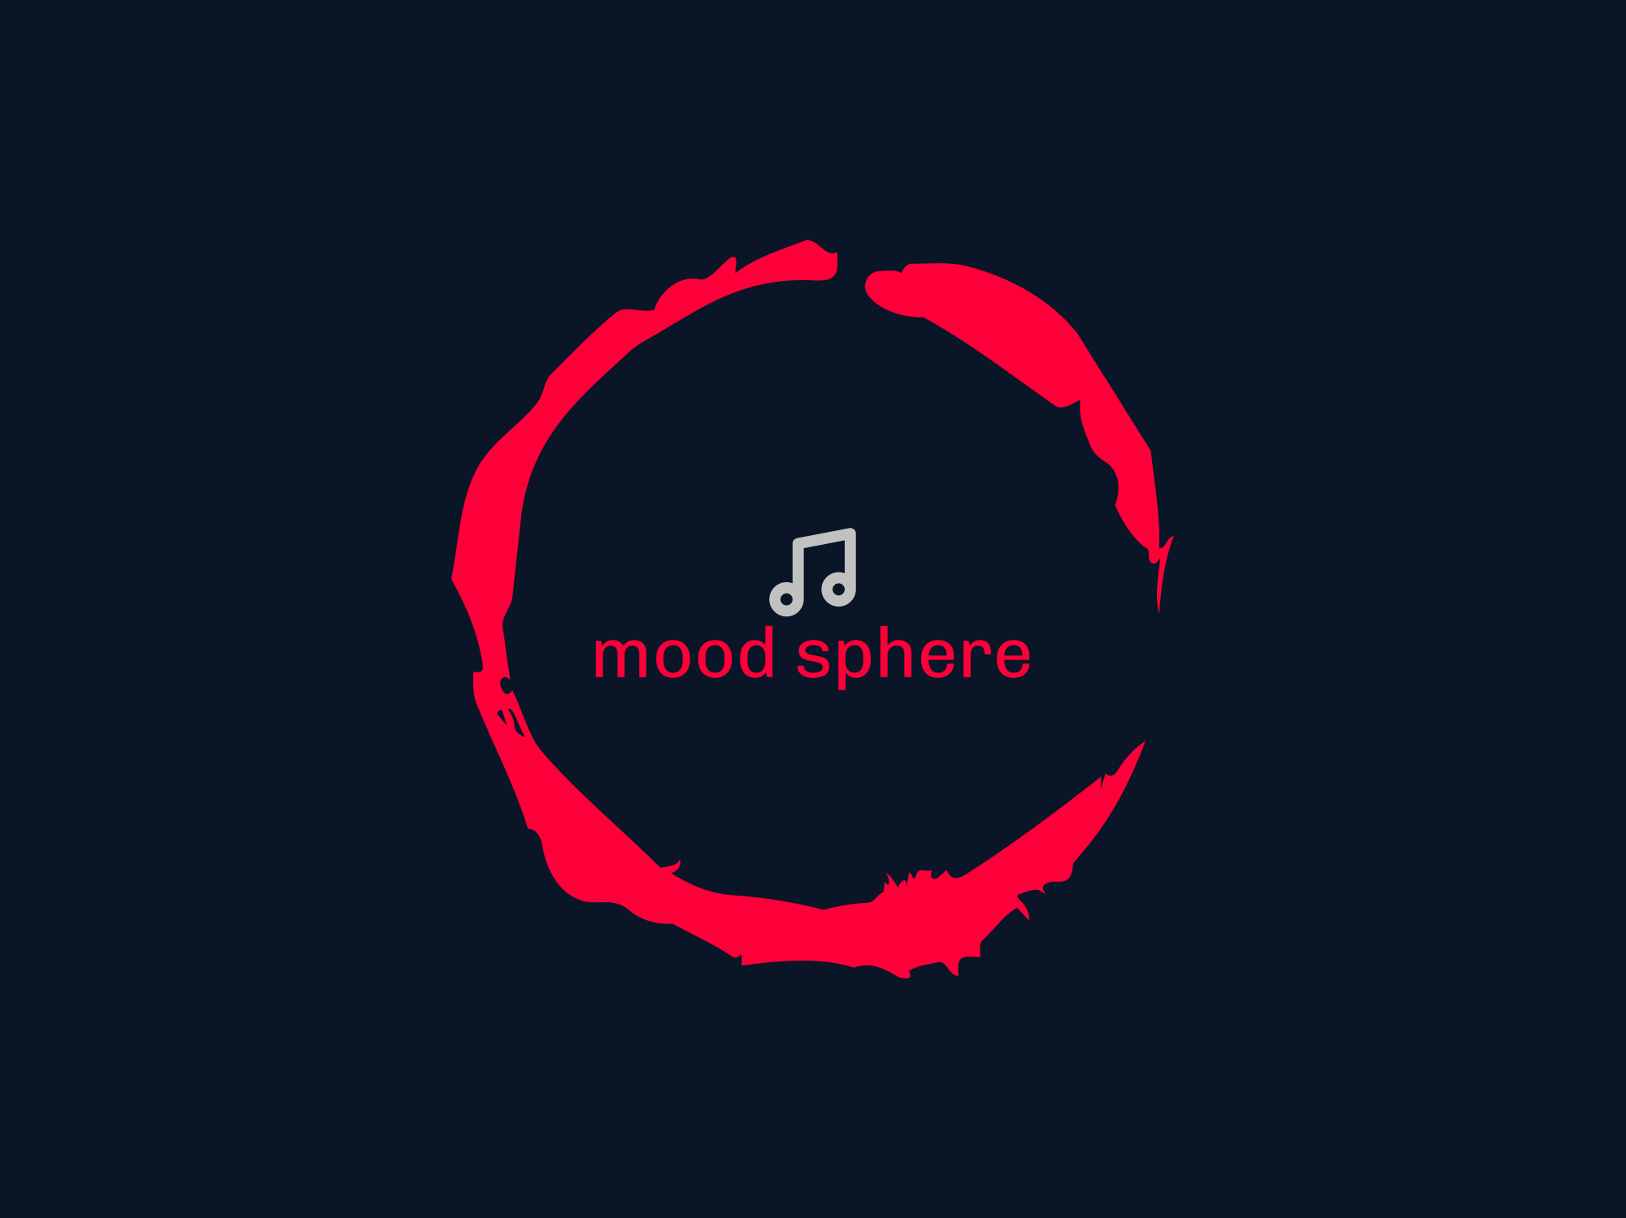


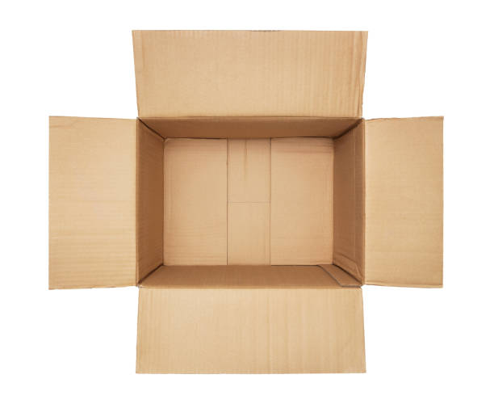
Architecture Diagram
user
Firebase database
MoodSphere
Input
API

Slide 27
Context Diagram
Upload Image
Mood
Sphere
API Out
Upload Image
API Call
Receive Mood
API In

Slide 28
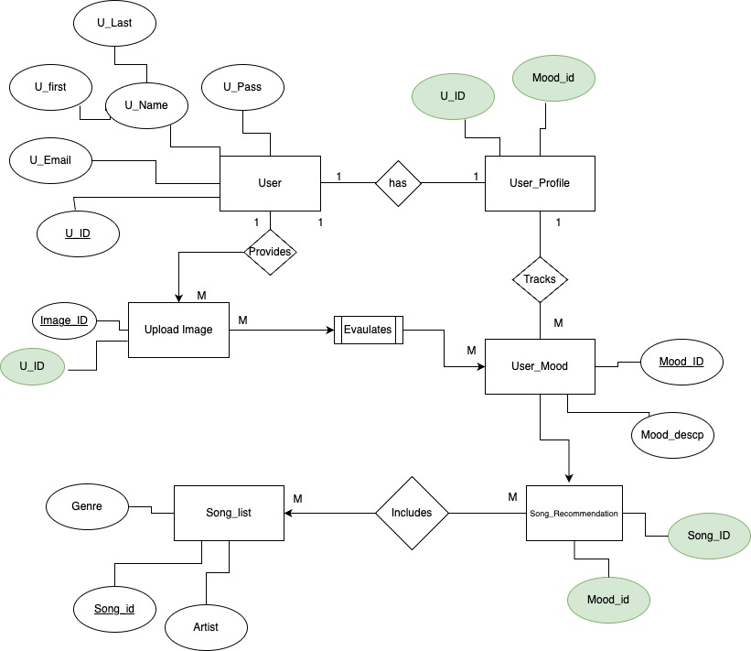
Entity relationship diagram

Slide 29
Sequence Diagram
Moodsphere
ML Model
Database
Upload Image
Analyze image
Predict Mood
API call requested for service
Sends the data to MoodSphere
Display the recommended song
29

Slide 30
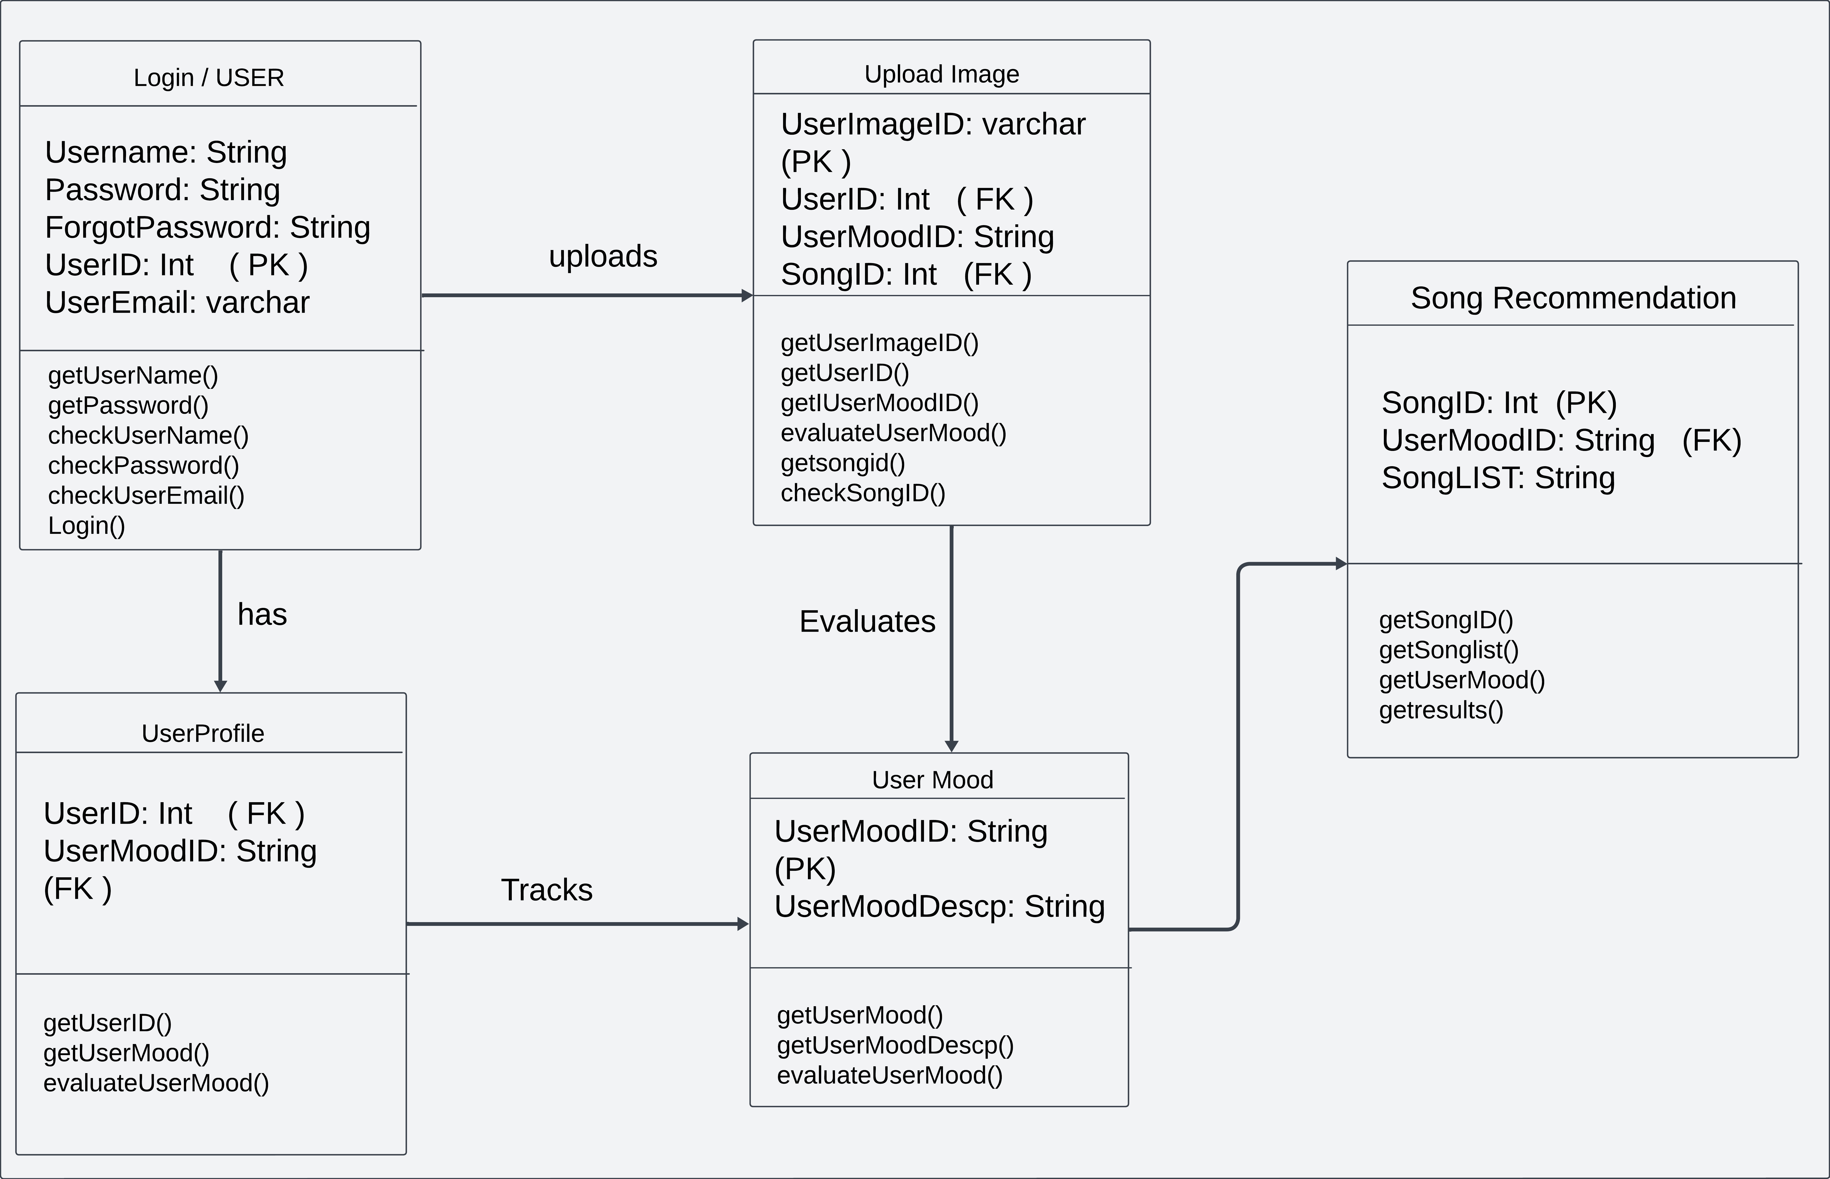
State diagram

Slide 31
Class Diagram
User
User ID (int)
Email (String)
Password(String)
API call
URI (String)
Webapp
ML Algorithm
Mood Analyzer(String)
Database
Name (String)
Album (String)
Artist (String)
Id (int)
Mood(Sting)
31

Slide 32

SPRINT 2 RECAP

Slide 33
MS_4 | 8 | As a user, I want to receive personalized music recommendations based on my current mood. | Done | Sprint-2
 |  | Criteria, The system should retrieve a list of songs associated with the predicted mood from a CSV file. Songs should be relevant and appropriate for the predicted mood.
MS_9 | 5 | As a user, I want to be able to explore different moods and receive recommendations tailored to each mood. | Done | Sprint-2
 |  | Criteria, Users should have the option to select different moods and receive corresponding song recommendations. Each mood selection should provide a unique set of recommended songs.
MS_13 | 5 | As a user, I want to be able to view and edit my profile information. | Done | Sprint-2
 |  | Criteria, Users can view and update their profile information (e.g., name, email, profile picture).Profile editing should be straightforward and secure.
MS_14 | 5 | As a user, I want to be able to sign up for an account to access personalized features and settings. | Done | Sprint-2
 |  | Criteria, Users can create a new account by providing necessary information (e.g., email, password).Account creation should include email verification for security purposes.
MS_18 | 5 | As a user, I want the application to provide a diverse range of song recommendations for each mood, including different genres and styles based on the popularity of the song. | Done | Sprint-2
 |  | Criteria, Recommended songs should cover a variety of genres and musical preferences. Users should have options to explore different music styles within each mood category with the recommndation based on popularity.
MS_19 | 5 | As a user, I want the application to be secure and protect my privacy when uploading pictures or interacting with the site. | Done | Sprint-2
 |  | Criteria, The application should use HTTPS to encrypt data transmission. User data should be stored securely and not shared with third parties without consent.
MS_26 | 3 | As a user, I want to view my current mood status without any song recommendations. | Done | Sprint-2
 |  | Criteria, Users can navigate to a separate page or section to view their current mood status. The mood status should be displayed visually (e.g., emoticons) along with a text description
MoodSphere

Slide 34
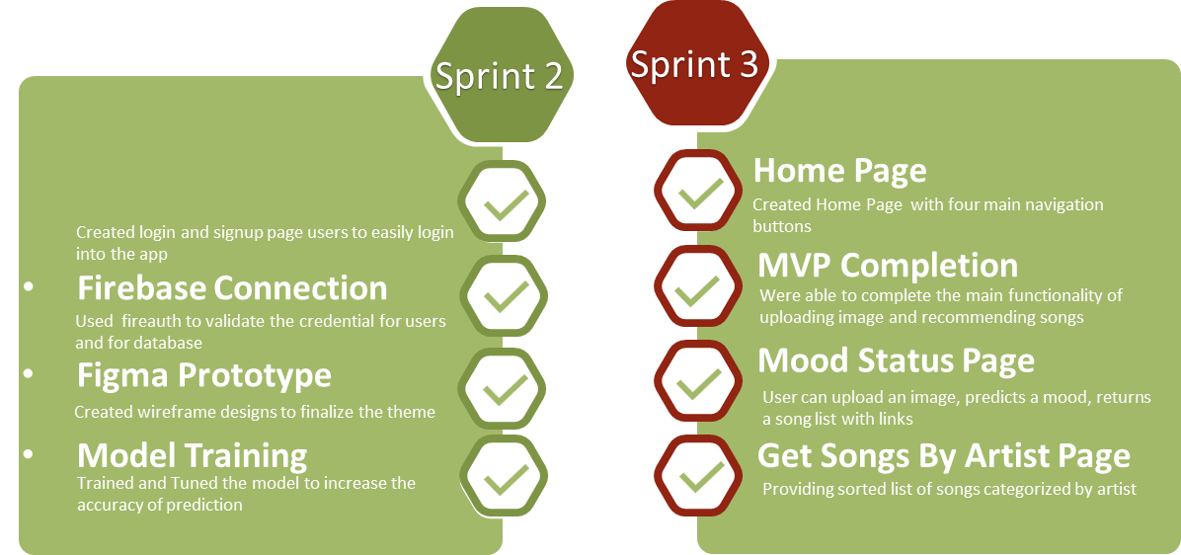


Slide 35
product Backlog

Slide 36
Task ID | Story Points | User Story | Status | Sprint
MS_4 | 3 | As a user, I want to receive personalized music recommendations based on my current mood. | Done | Sprint - 2
 |  | Criteria, The system should retrieve a list of songs associated with the predicted mood from a CSV file.Songs should be relevant and appropriate for the predicted mood.
MS_9 | 5 | As a user, I want to be able to explore different moods and receive recommendations tailored to each mood. | Done | Sprint - 2
 |  | Criteria, Users should have the option to select different moods and receive corresponding song recommendations.Each mood selection should provide a unique set of recommended songs.
MS_13 | 5 | As a user, I want to be able to view and edit my profile information. | Done | Sprint - 2
 |  | Criteria, Users can view and update their profile information (e.g., name, email, profile picture).Profile editing should be straightforward and secure.
MS_14 | 5 | As a user, I want to be able to sign up for an account to access personalized features and settings. | Done | Sprint - 2
 |  | Criteria, Users can create a new account by providing necessary information (e.g., email, password).Account creation should include email verification for security purposes.
MS_18 | 5 | As a user, I want the application to provide a diverse range of song recommendations for each mood, including different genres and styles based on the popularity of the song. | Done | Sprint - 2
 |  | Criteria, Recommended songs should cover a variety of genres and musical preferences.Users should have options to explore different music styles within each mood category with the recommendation based on popularity.
36

Slide 37
Task ID | Story Points | User Story | Status | Sprint
MS_19 | 5 | As a user, I want the application to be secure and protect my privacy when uploading pictures or interacting with the site. | Done | Sprint - 2
 |  | Criteria, The application should use HTTPS to encrypt data transmission.User data should be stored securely and not shared with third parties without consent.
MS_26 | 3 | As a user, I want to view my current mood status without any song recommendations. | Done | Sprint - 2
 |  | Criteria, Users can navigate to a separate page or section to view their current mood status.The mood status should be displayed visually (e.g., emoticons) along with a text description
MS_1 | 3 | As a user, I want to be able to upload a picture representing my current mood From the Already Saved Images in the gallery | In Progress | Sprint - 3
 |  | Criteria, The user can upload an image file.Supported image formats include JPG, PNG, and GIF.
MS_2 | 5 | As a user, I want the system to analyze the uploaded picture to determine my current mood More Precisely. | Done | Sprint - 3
 |  | Criteria, The system should use a CNN model to extract features from the image.The model should classify the mood into predefined categories (e.g., happy, sad, angry) More Precisely
MS_3 | 2 | As a user, I want to see the predicted mood based on the uploaded picture. | Done | Sprint - 3
 |  | Criteria, The predicted mood should be displayed to the user.The mood prediction should be visually represented (e.g., emoticons).
Sample Footer Text

Slide 38
Task ID | Story Points | User Story | Status | Sprint
MS_6 | 3 | As a user, I want to be able to navigate the application easily and intuitively. | Done | Sprint - 3
 |  | Criteria, The application should have clear navigation menus and buttons.Users should be able to easily switch between different sections of the application.
MS_7 | 5 | As a user, I want the application to be responsive and work well on different devices, including desktops, tablets, and smartphones. | Done | Sprint - 3
 |  | Criteria, The application should adapt to different screen sizes and resolutions.All features should be accessible and functional on various devices.
MS_8 | 5 | As a user, I want to be able to search for specific songs or artists. | In Progress | Sprint - 3
 |  | Criteria, Users can search for songs or artists using a search bar.Search results should be relevant and displayed in a clear manner.
MS_12 | 5 | As a user, I want the application to provide an option to sort recommended songs based on popularity or other criteria. | Done | Sprint - 3
 |  | As a user, I want the application to provide an option to sort recommended songs based on popularity or other criteria.
MS_16 | 3 | As a user, I want to be able to access external links associated with each recommended song. | Done | Sprint - 3
 |  | Criteria, The list of songs should include external links in one column, allowing users to access additional information or listen to the song.
38

Slide 39
Task ID | Story Points | User Story | Status | Sprint
 | MS_22 | 3 | As a user, I want the application to display the mood category along with each recommended song. | Done | Sprint - 3
 |  |  | Criteria, Each recommended song entry should include the corresponding mood category.Mood categories should be clearly labeled and easy to distinguish.
MS_23 | 5 | As a user, I want the application to provide recommendations based on my current mood, even if I'm not logged in or don't have an account. | In Progress | Sprint - 3
 |  | Criteria, Users should be able to access mood-based recommendations without requiring authentication or account creation.
MS_5 | 5 | Criteria, Users should be able to access mood-based recommendations without requiring authentication or account creation. | To Do | Sprint - 4
 |  | Criteria, Users should have the option to add songs to a personal playlist.The playlist should persist across sessions for registered users.
MS_10 | 3 | As a user, I want to be able to create and customize multiple playlists for different moods or occasions. | To Do | Sprint - 4
 |  | Criteria, Users can create new playlists and give them custom names.Users can add or remove songs from playlists.
MS_11 | 5 | As a user, I want the application to provide additional information about recommended songs | To Do | Sprint - 4
 |  | Criteria, Users can access additional information about recommended songs by clicking on them.Information should be presented in a clear and concise manner.
39

Slide 40
Task ID | Story Points | User Story | Status | Sprint
MS_15 | 5 | As a user, I want to be able to provide feedback on recommended songs or report any issues encountered while using the application. | To Do | Sprint - 4
 |  | Criteria, Users should have a feedback mechanism to submit comments or report problems orproblems.
MS_17 | 3 | As a user, I want to be able to clear my mood selection and start over if I'm not satisfied with the recommended songs. | To Do | Sprint - 4
 |  | Criteria, Users should have the option to clear their mood selection and return to the initial state.Clearing the mood selection should reset the recommended songs.
MS_20 | 3 | As a user, I want the application to provide clear instructions and guidance on how to use its features effectively. | To Do | Sprint - 4
 |  | Criteria, The application should include help documentation or tooltips to explain its functionality.
MS_21 | 3 | As a user, I want the application to display loading indicators or progress bars to indicate when mood analysis and song retrieval are in progress. | To Do | Sprint - 4
 |  | Criteria, Users should see visual cues indicating that the application is processing their request.Loading indicators should be displayed prominently and disappear once processing is complete.
MS_24 | 3 | As a user, I want the application to store uploaded pictures for future reference. | To Do | Sprint - 4
 |  | Criteria, Uploaded pictures should be saved securely in the user's account.Users should be able to access their stored pictures from their profile or settings.
MoodSphere
40

Slide 41
Task ID | Story Points | User Story | Status | Sprint
MS_25 | 3 | As a user, I want the ability to delete uploaded pictures if needed. | Done | Sprint - 4
 |  | Criteria, Users can delete uploaded pictures from their account.Deletion should be confirmed with a confirmation prompt to prevent accidental deletion.
MoodSphere
41

Slide 42
sprint-3 BackLog

Slide 43
sprint-3 User Stories & Acceptance Criteria

Slide 44
Task ID | Story Points | User Story | Status | Sprint
MS_1 | 3 | As a user, I want to be able to upload a picture representing my current mood From the Already Saved Images in the gallery | In Progress | Sprint - 3
 |  | Criteria, The user can upload an image file.Supported image formats include JPG, PNG, and GIF.
MS_2 | 5 | As a user, I want the system to analyze the uploaded picture to determine my current mood More Precisely. | Done | Sprint - 3
 |  | Criteria, The system should use a CNN model to extract features from the image.The model should classify the mood into predefined categories (e.g., happy, sad, angry) More Precisely
MS_3 | 2 | As a user, I want to see the predicted mood based on the uploaded picture. | Done | Sprint - 3
 |  | Criteria, The predicted mood should be displayed to the user.The mood prediction should be visually represented (e.g., emoticons).
MS_6 | 3 | As a user, I want to be able to navigate the application easily and intuitively. | Done | Sprint - 3
 |  | Criteria, The application should have clear navigation menus and buttons.Users should be able to easily switch between different sections of the application.
 | MS_22 | 3 | As a user, I want the application to display the mood category along with each recommended song. | Done | Sprint - 3
 |  |  | Criteria, Each recommended song entry should include the corresponding mood category.Mood categories should be clearly labeled and easy to distinguish.
MS_23 | 5 | As a user, I want the application to provide recommendations based on my current mood, even if I'm not logged in or don't have an account. | In Progress | Sprint - 3
 |  | Criteria, Users should be able to access mood-based recommendations without requiring authentication or account creation.

Slide 45
Task ID | Story Points | User Story | Status | Sprint
MS_7 | 5 | As a user, I want the application to be responsive and work well on different devices, including desktops, tablets, and smartphones. | Done | Sprint - 3
 |  | Criteria, The application should adapt to different screen sizes and resolutions.All features should be accessible and functional on various devices.
MS_8 | 5 | As a user, I want to be able to search for specific songs or artists. | In Progress | Sprint - 3
 |  | Criteria, Users can search for songs or artists using a search bar.Search results should be relevant and displayed in a clear manner.
MS_12 | 5 | As a user, I want the application to provide an option to sort recommended songs based on popularity or other criteria. | Done | Sprint - 3
 |  | As a user, I want the application to provide an option to sort recommended songs based on popularity or other criteria.
MS_16 | 3 | As a user, I want to be able to access external links associated with each recommended song. | Done | Sprint - 3
 |  | Criteria, The list of songs should include external links in one column, allowing users to access additional information or listen to the song.
MoodSphere

Slide 46
Testcases For sprint-3 Backlog

Slide 47
MoodSphere

Slide 48
MoodSphere

Slide 49
Completed stories in sprint-3
MoodSphere

Slide 50
Task ID | Story Points | User Story | Status | Sprint
MS_2 | 5 | As a user, I want the system to analyze the uploaded picture to determine my current mood More Precisely. | Done | Sprint - 3
 |  | Criteria, The system should use a CNN model to extract features from the image.The model should classify the mood into predefined categories (e.g., happy, sad, angry) More Precisely
MS_3 | 2 | As a user, I want to see the predicted mood based on the uploaded picture. | Done | Sprint - 3
 |  | Criteria, The predicted mood should be displayed to the user.The mood prediction should be visually represented (e.g., emoticons).
MS_6 | 3 | As a user, I want to be able to navigate the application easily and intuitively. | Done | Sprint - 3
 |  | Criteria, The application should have clear navigation menus and buttons.Users should be able to easily switch between different sections of the application.
MS_7 | 5 | As a user, I want the application to be responsive and work well on different devices, including desktops, tablets, and smartphones. | Done | Sprint - 3
 |  | Criteria, The application should adapt to different screen sizes and resolutions.All features should be accessible and functional on various devices.
MoodSphere

Slide 51
Task ID | Story Points | User Story | Status | Sprint
MS_12 | 5 | As a user, I want the application to provide an option to sort recommended songs based on popularity or other criteria. | Done | Sprint - 3
 |  | As a user, I want the application to provide an option to sort recommended songs based on popularity or other criteria.
MS_16 | 3 | As a user, I want to be able to access external links associated with each recommended song. | Done | Sprint - 3
 |  | Criteria, The list of songs should include external links in one column, allowing users to access additional information or listen to the song.
MS_22 | 3 | As a user, I want the application to display the mood category along with each recommended song. | Done | Sprint - 3
 |  | Criteria, Each recommended song entry should include the corresponding mood category.Mood categories should be clearly labeled and easy to distinguish.
MoodSphere 51

Slide 52
inCompleted stories in sprint-3
MoodSphere

Slide 53
Task ID | Story Points | User Story | Status | Sprint
MS_1 | 3 | As a user, I want to be able to upload a picture representing my current mood From the Already Saved Images in the gallery | In Progress | Sprint - 3
 |  | Criteria, The user can upload an image file.Supported image formats include JPG, PNG, and GIF.
MS_8 | 5 | As a user, I want to be able to search for specific songs or artists. | In Progress | Sprint - 3
 |  | Criteria, Users can search for songs or artists using a search bar.Search results should be relevant and displayed in a clear manner.
MS_23 | 5 | As a user, I want the application to provide recommendations based on my current mood, even if I'm not logged in or don't have an account. | In Progress | Sprint - 3
 |  | Criteria, Users should be able to access mood-based recommendations without requiring authentication or account creation.
MoodSphere

Slide 54
metrics

Slide 55
Sprint -3 Team Velocity

Slide 56
Team velocity for sprint- 3 is (Number of completed stories) = 26

Slide 57
Team’s Historical Velocity

Slide 58
Average Velocity =
Sum of Velocities for Completed Sprints Number of completed sprints
Historical Velocity of Moodsphere is 29.5

Slide 59
Burndown charts

Slide 60
Sprint-3 Burndown chart

Slide 61
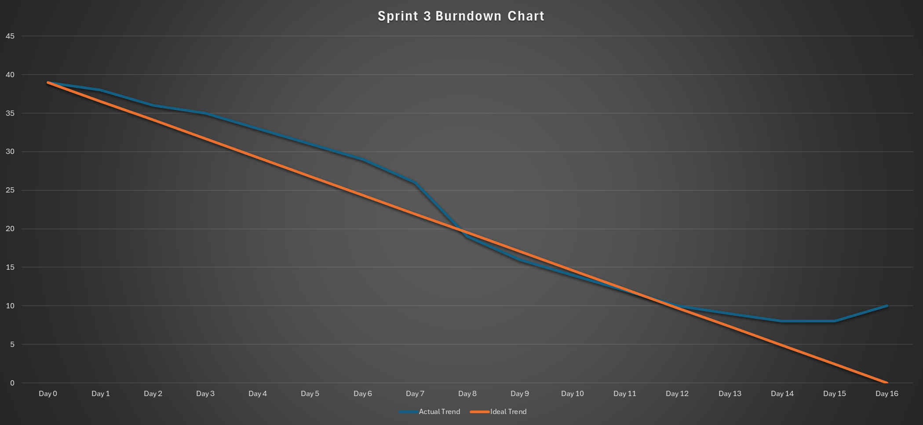
Sprint 3 Burndown Chart

Slide 62
Historical Burndown chart
Historical burndown chart = Sum(Sprint 1 + Sprint 2 + Sprint 3)

Slide 63
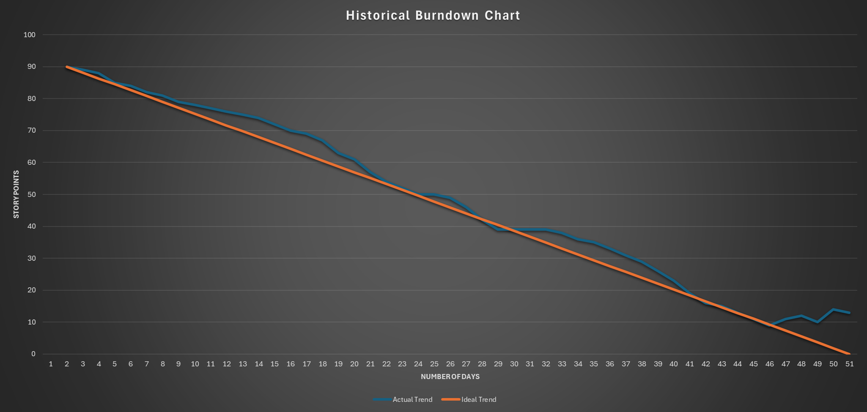
Historical Burndown Chart

Slide 64
Average Burndown chart
Average Burndown Rate = Total Variance/ Total Number of Intervals
Where:
Total Variance = Σ (Ideal Burndown - Actual Burndown) for all intervals
Total Number of Intervals = Number of intervals (e.g., days, weeks) during the project duration. In our Case it is 3days.

Slide 65
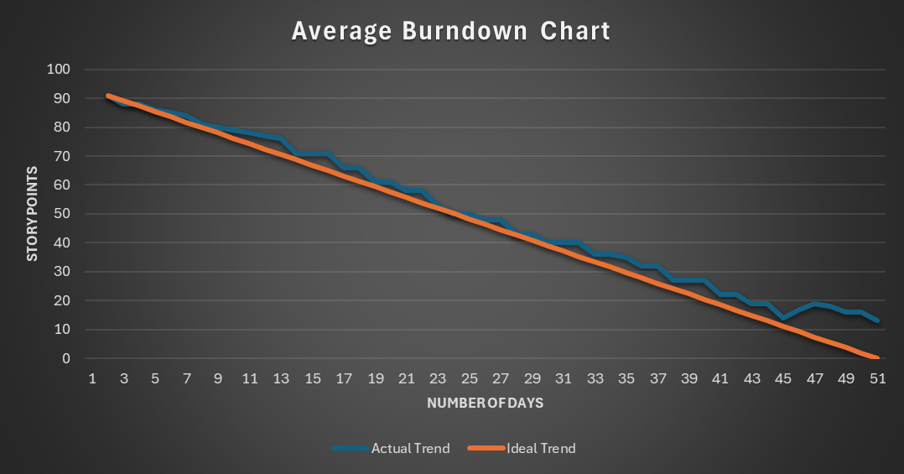
Average Burndown Chart

Slide 66
Sprint -3 Completed/committed Ratio

Slide 67
Completed/committed Ratio for Sprint – 3 is
26/39 = 66.67%

Slide 68
Average Completed/committed Ratio

Slide 69
Average Ratio =
AvG(Sprint-2 ratio+sprint-3 Ratio)
Average Ratio is - 79.17%

Slide 70
Historic Completed/committed Ratio

Slide 71
Historic Ratio =
Total completed work Total committed work
Historic Ratio is – 78.66%

Slide 72
RETROSPECTIVE
MoodSphere

Slide 73
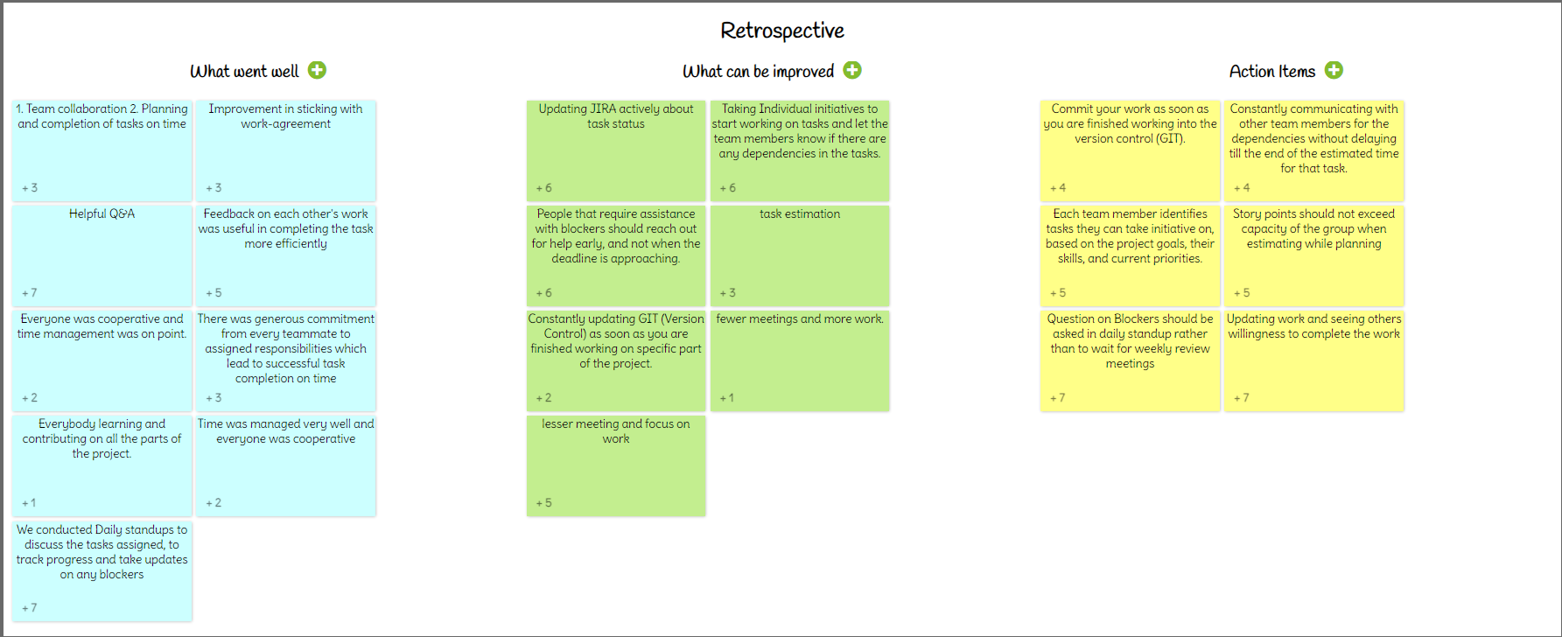

Slide 74
sprint-4 Backlog

Slide 75
Task ID | Story Points | User Story | Status | Sprint
MS_1 | 3 | As a user, I want to be able to upload a picture representing my current mood From the Already Saved Images in the gallery | In Progress | Sprint - 3
 |  | Criteria, The user can upload an image file.Supported image formats include JPG, PNG, and GIF.
MS_8 | 5 | As a user, I want to be able to search for specific songs or artists. | In Progress | Sprint - 3
 |  | Criteria, Users can search for songs or artists using a search bar.Search results should be relevant and displayed in a clear manner.
MS_23 | 5 | As a user, I want the application to provide recommendations based on my current mood, even if I'm not logged in or don't have an account. | In Progress | Sprint - 3
 |  | Criteria, Users should be able to access mood-based recommendations without requiring authentication or account creation.
MS_24 | 3 | As a user, I want the application to store uploaded pictures for future reference. | To Do | sprint -4
 |  | Criteria, Uploaded pictures should be saved securely in the user's account. Users should be able to access their stored pictures from their profile or settings.
MS_25 | 3 | As a user, I want the ability to delete uploaded pictures if needed. | To Do | sprint -4
 |  | Criteria, Users can delete uploaded pictures from their account. Deletion should be confirmed with a confirmation prompt to prevent accidental deletion.
MS_21 | 3 | As a user, I want the application to display loading indicators or progress bars to indicate when mood analysis and song retrieval are in progress. | To Do | sprint -4
 |  | Criteria, Users should see visual cues indicating that the application is processing their request. Loading indicators should be displayed prominently and disappear once processing is complete.
MoodSphere

Slide 76
Task ID | Story Points | User Story | Status | Sprint
MS_5 | 5 | As a user, I want to be able to save songs I like to a playlist for future listening. | To Do | sprint -4
 |  | Criteria, Users should have the option to add songs to a personal playlist. The playlist should persist across sessions for registered users.
MS_10 | 3 | As a user, I want to be able to create and customize multiple playlists for different moods or occasions. | To Do | sprint -4
 |  | Criteria, Users can create new playlists and give them custom names. Users can add or remove songs from playlists.
MS_11 | 5 | As a user, I want the application to provide additional information about recommended songs | To Do | sprint -4
 |  | Criteria, Users can access additional information about recommended songs by clicking on them. Information should be presented in a clear and concise manner.
MS_15 | 5 | As a user, I want to be able to provide feedback on recommended songs or report any issues encountered while using the application. | To Do | sprint -4
 |  | Criteria, Users should have a feedback mechanism to submit comments or report problems.
MS_17 | 3 | As a user, I want to be able to clear my mood selection and start over if I'm not satisfied with the recommended songs. | To Do | sprint -4
 |  | Criteria, Users should have the option to clear their mood selection and return to the initial state. Clearing the mood selection should reset the recommended songs.
MS_20 | 3 | As a user, I want the application to provide clear instructions and guidance on how to use its features effectively. | To Do | sprint -4
 |  | Criteria, The application should include help documentation or tooltips to explain its functionality.

Slide 77
PROJECT DEMO

Slide 78
App Screenshots

Slide 79
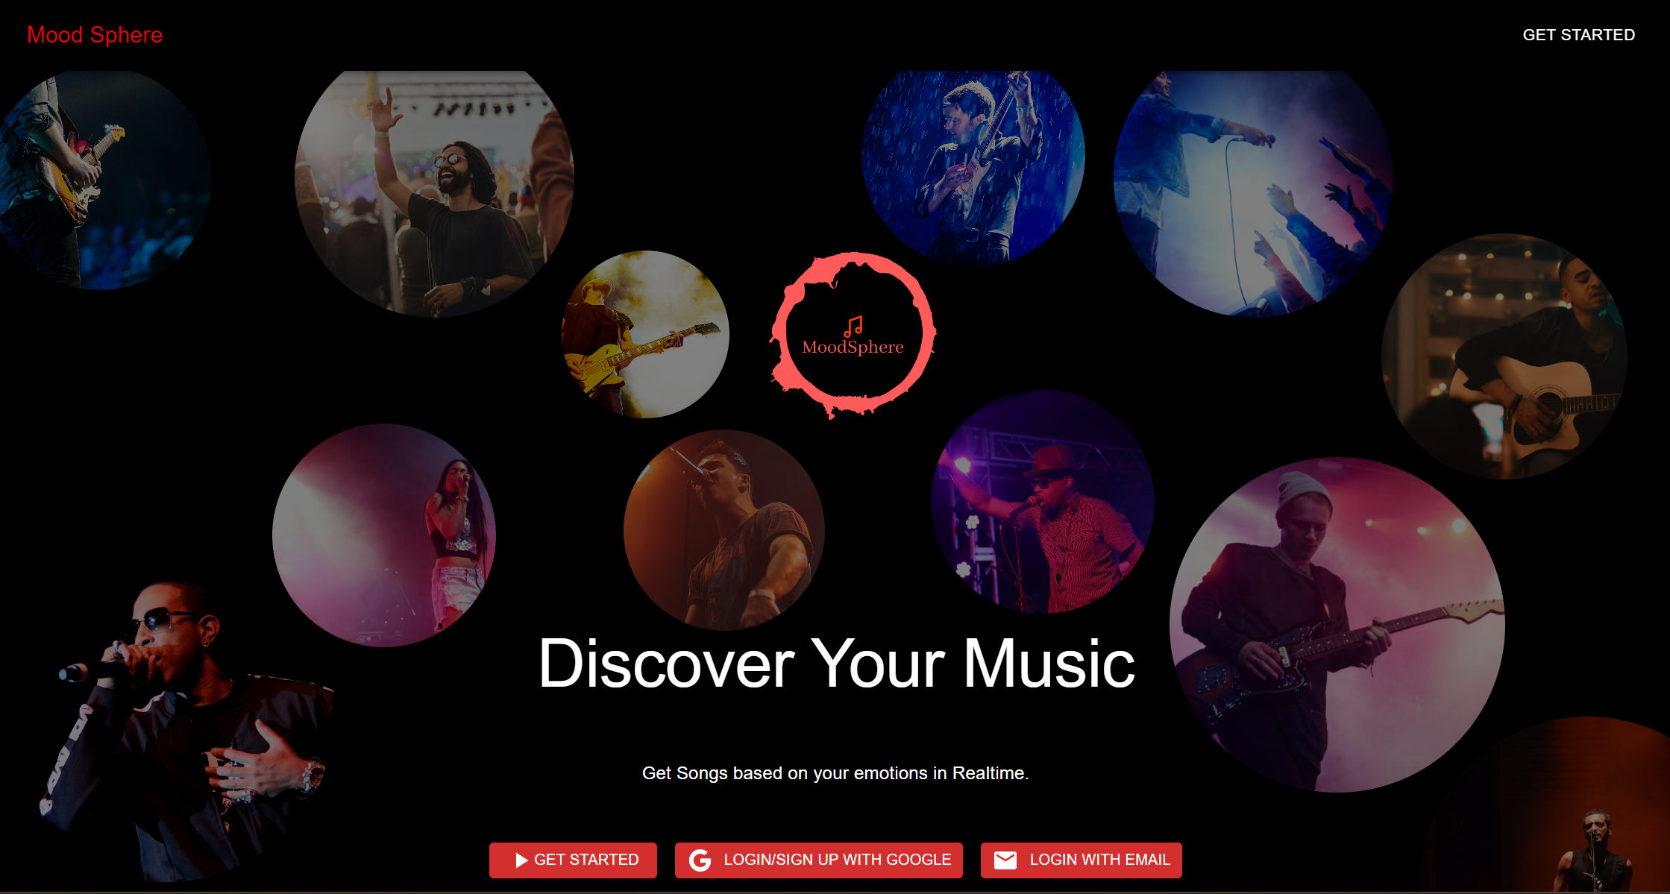
Landing Page

Slide 80
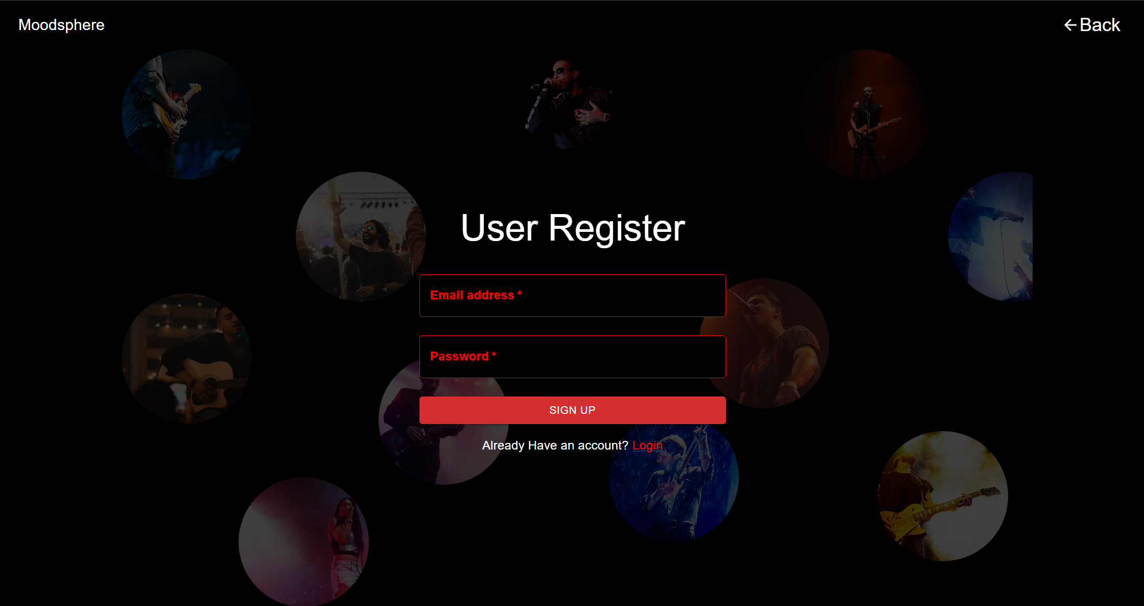
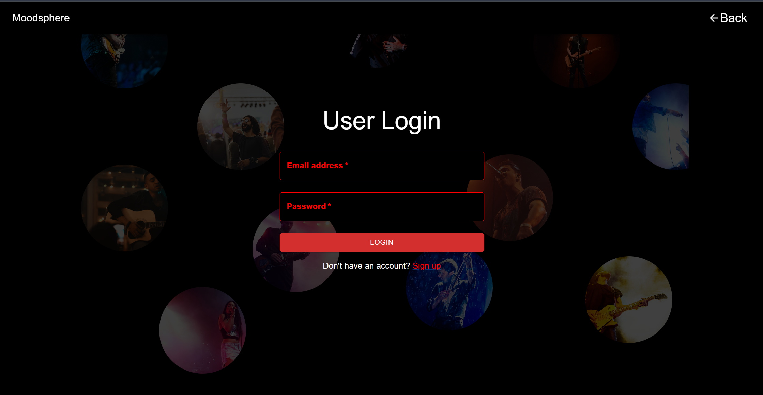
Signup
Login

Slide 81
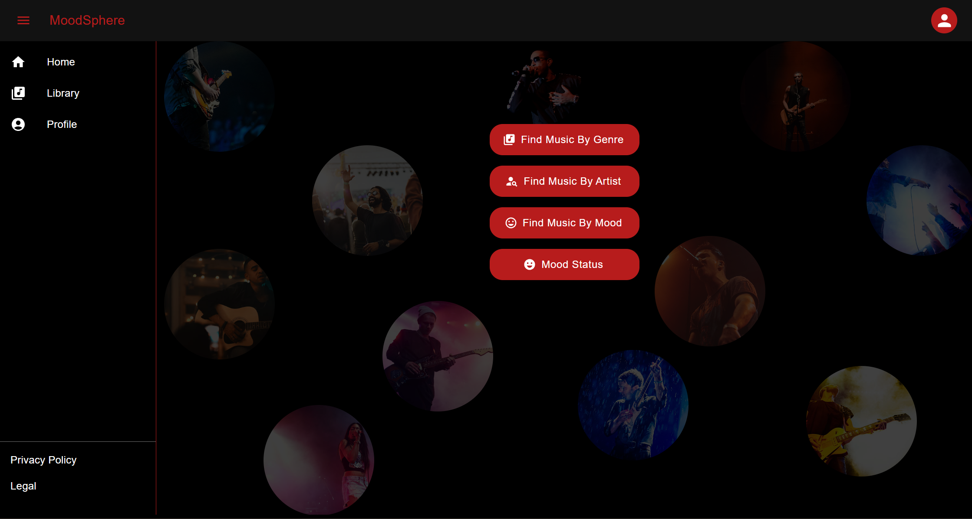
Home Page

Slide 82
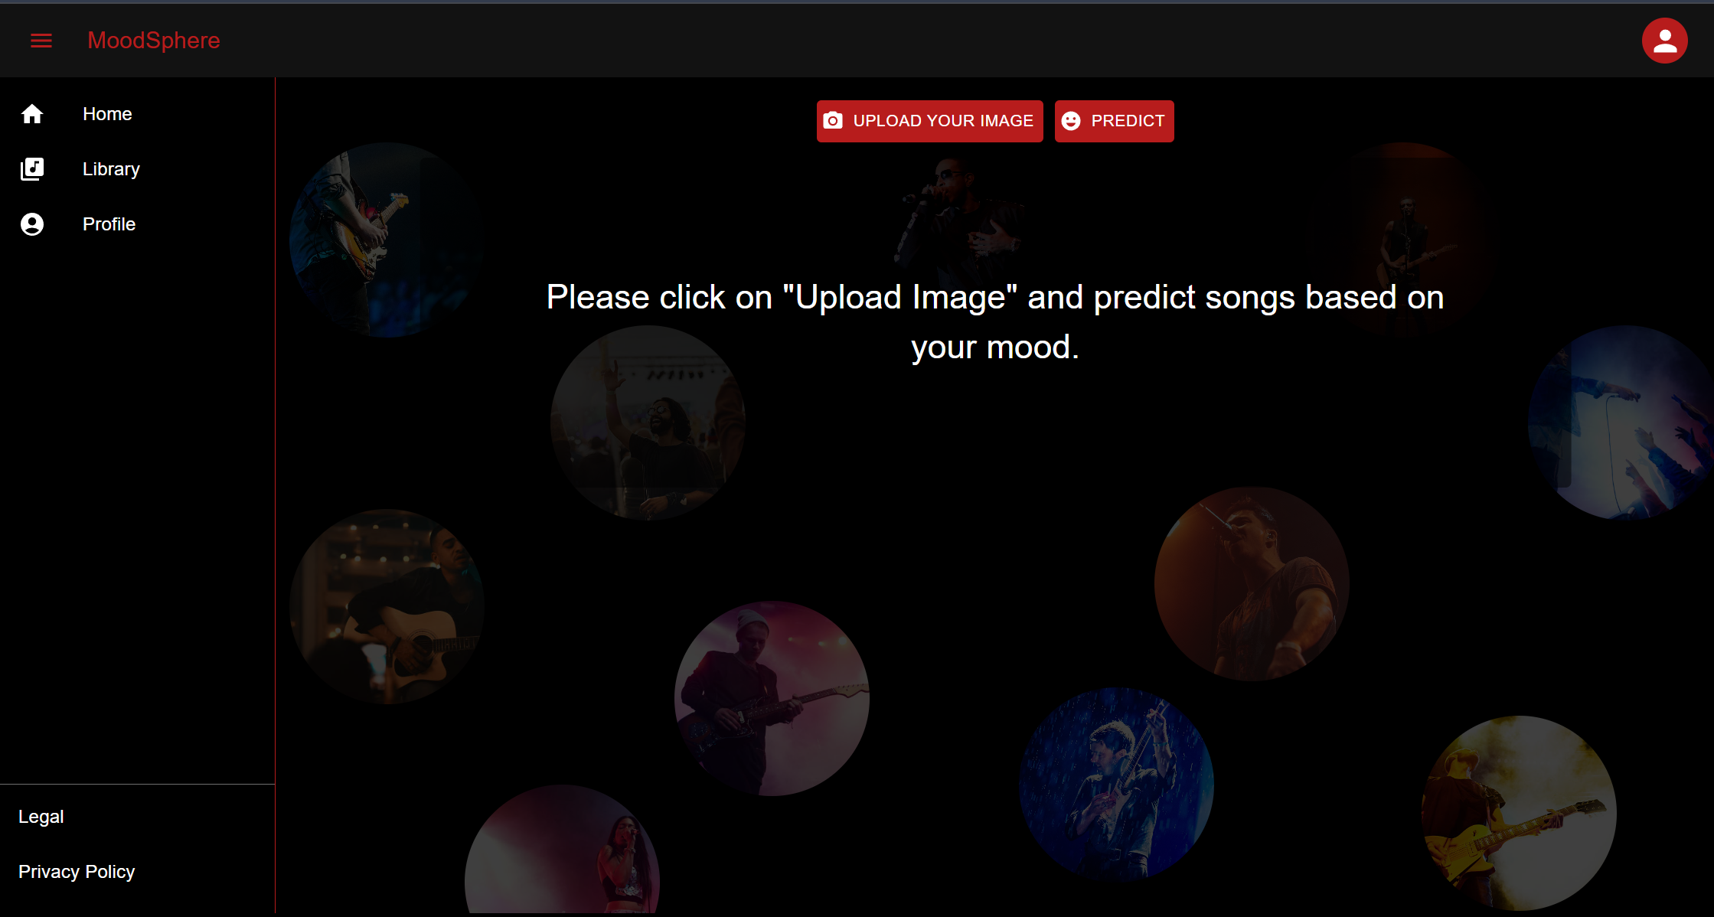
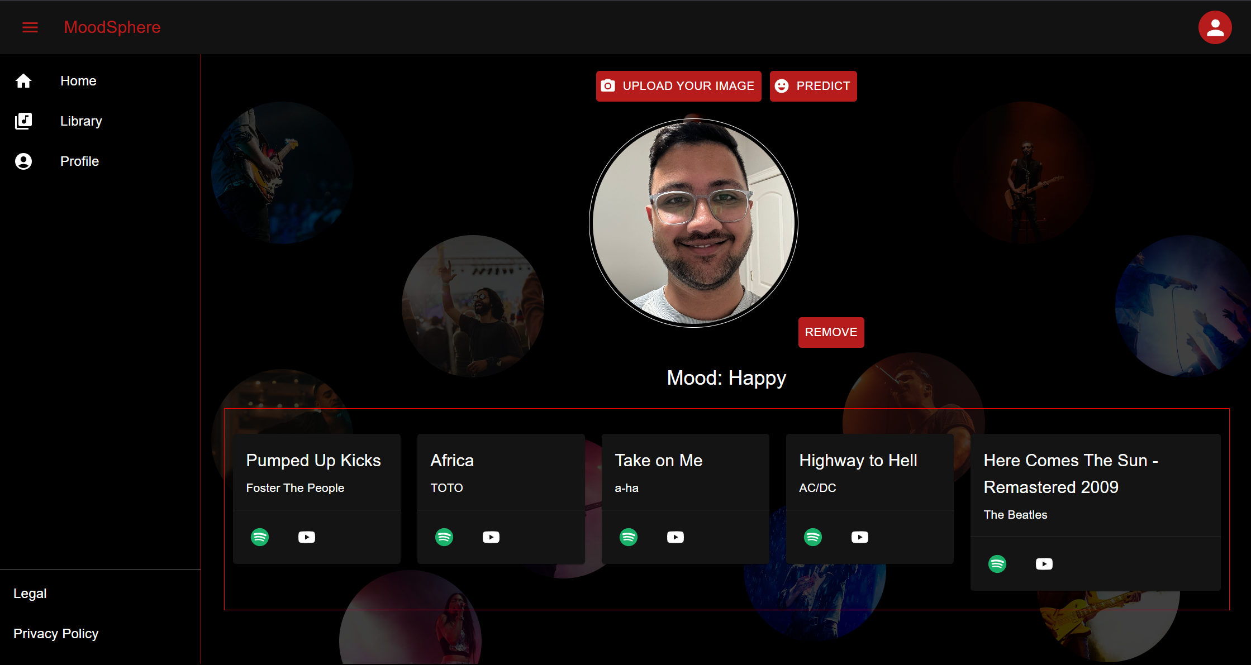
Mood Prediction and Song Recommendation

Slide 83
ApI SLIDES

Slide 84
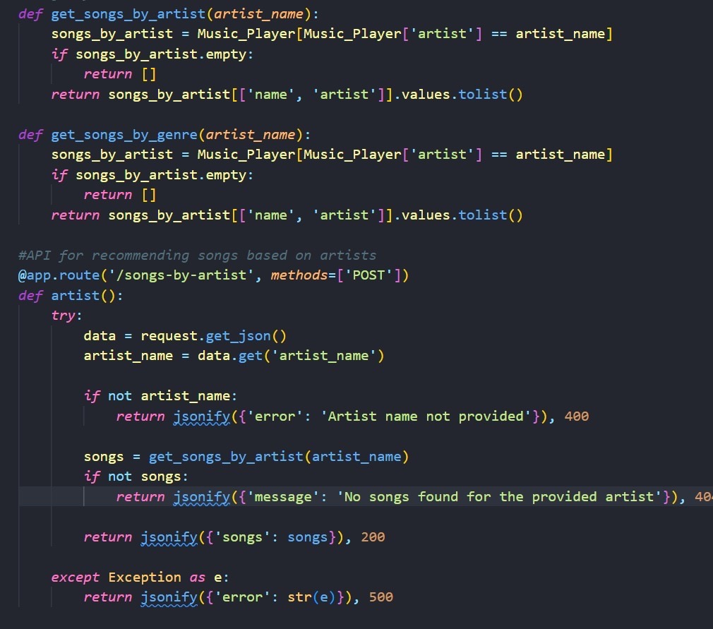
API Endpoint: /songs-by-artist
This API endpoint “/songs-by-artist” is designed to recommend songs based on a provided artist name.
The API endpoint accepts POST requests and expects to receive a JSON payload containing an artist name. It processes this input to find and return a list of songs associated with the specified artist.
Upon receiving the request, it attempts to parse the JSON to extract the artist's name.
If no artist name is provided, it responds with an error and a 400-status code. If an artist name is given, it then uses the get_songs_by_artist function to retrieve the corresponding songs

Slide 85
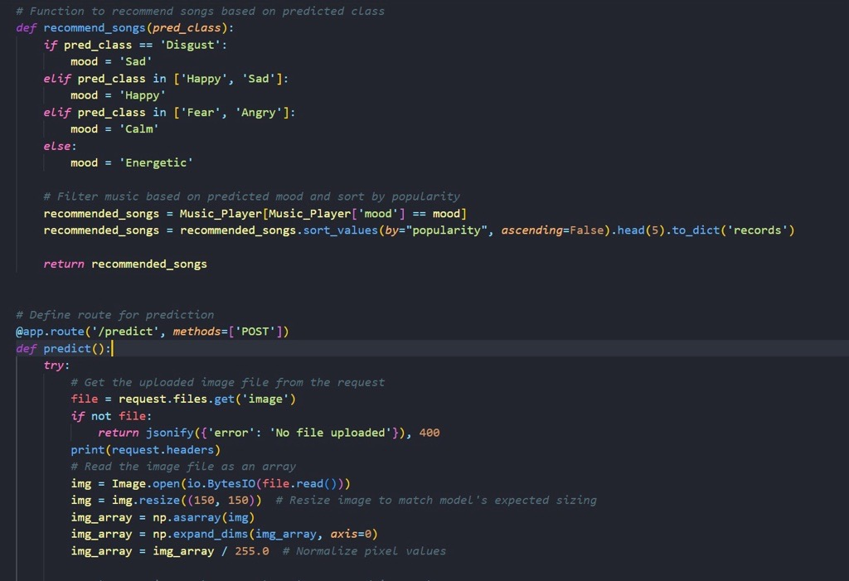
API Endpoint: /predict
The function recommend_songs takes a predicted class of mood from an image and maps it to a corresponding mood category. For example, 'Disgust' is mapped to 'Sad', and combinations like ['Happy', 'Sad'] or ['Fear', 'Angry'] are mapped to 'Happy' or 'Calm' respectively. Any other mood prediction results in the 'Energetic' category.
Once the mood is determined, the system filters the songs from the Music_Player dataset that match the mood category. Then it sorts these songs by their popularity in descending order and returns the top 5 as a dictionary in the 'records' format.

Slide 86
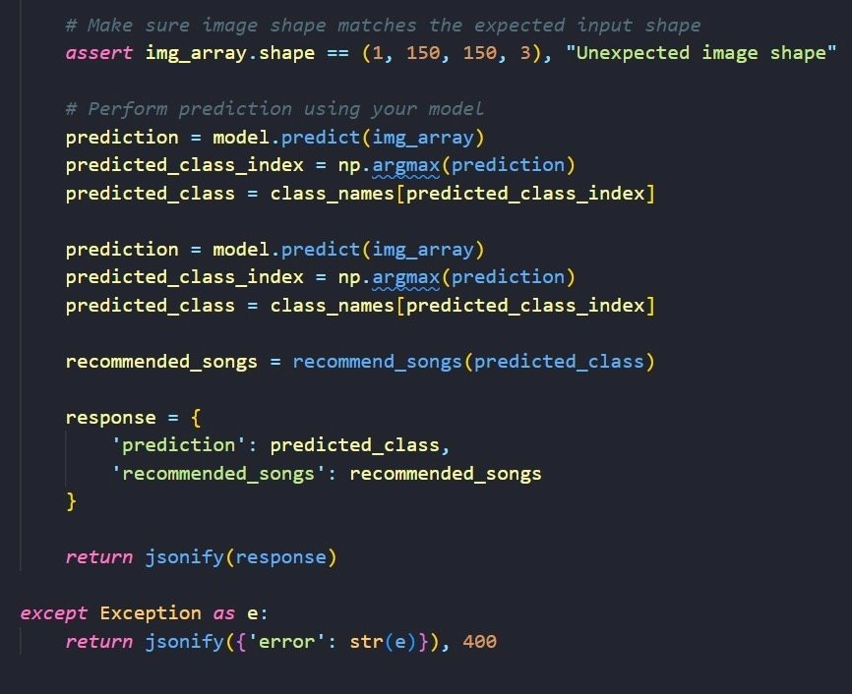
API Endpoint: /predict
Before making a prediction, the code asserts that the shape of the pre-processed image array matches the expected input shape for the model, which is (1, 150, 150, 3). If the shape does not match, an assertion error with the message "Unexpected image shape" will be raised.
The response is constructed as a JSON object with two fields: 'prediction', containing the name of the predicted mood class, and 'recommended_songs', containing the list of songs recommended by the system. This response is then returned to the client. If an exception occurs during the process, an error response with a 400-status code and the exception message is returned.

Slide 87
GITHUB Link https://github.com/htmw/2024S-Dev-Dynasty/wiki

Slide 88
LIVE APPLICATION DEMO LINk https://www.youtube.com/watch?v=O0ubhMgBNQg&feature=youtu.be

Slide 89

Thank you
DevDynasty

